Slide 1

Job Guard: Detecting Job Scams Using Flask & AWS SageMaker
Presented by: Kandukuri Jaswanth

Slide 2

Introduction
Amazon SageMaker is a fully managed service that empowers developers and data scientists to efficiently build, train, and deploy machine learning models at scale. Deploying a model in SageMaker requires seamless integration with Amazon S3 for data storage, a Virtual Private Cloud (VPC) for secure networking, and an AWS Identity and Access Management (IAM) role for access control. The process begins by storing training data in an S3 bucket and configuring IAM roles with necessary permissions. Next, a SageMaker notebook or training job is launched within a secure VPC. Finally, the trained model is deployed as an endpoint, enabling real-time inference with enhanced security and scalability.

Slide 3
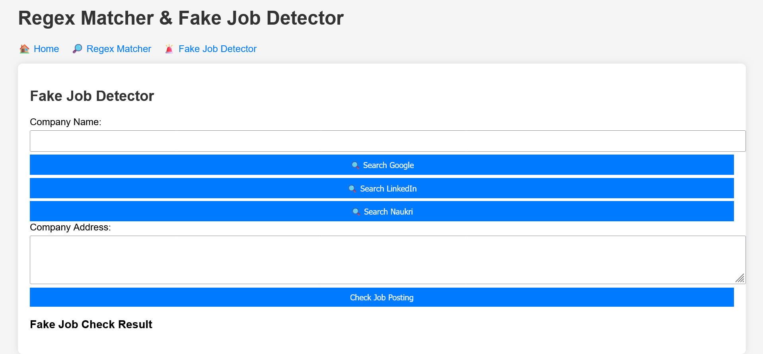
Objective
Detect fake job postings using Machine Learning
Deploy the application using Flask & AWS SageMaker

Slide 4
Technology Stack
Front-End: HTML (sai.html)
Back-End: Python (Flask) (app.py)
Deployment: AWS SageMaker, S3, IAM, VPC

Slide 5
Code Development in VS Code
Step 1: Writing Flask Backend (app.py)
Built a Flask app to handle requests
Integrated a machine learning model for fake job detection
Step 2: Creating Front-End (sai.html)
Designed a simple HTML page for users to input job details
Connected the form with Flask using JavaScript and Flask routes

Slide 6
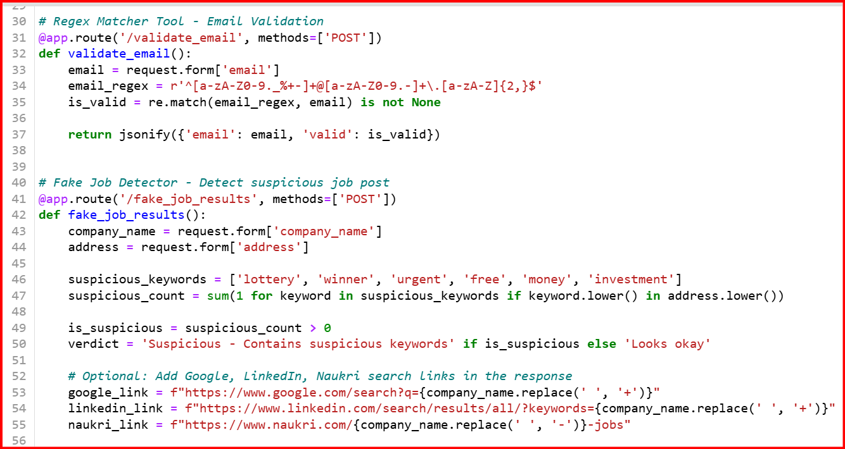
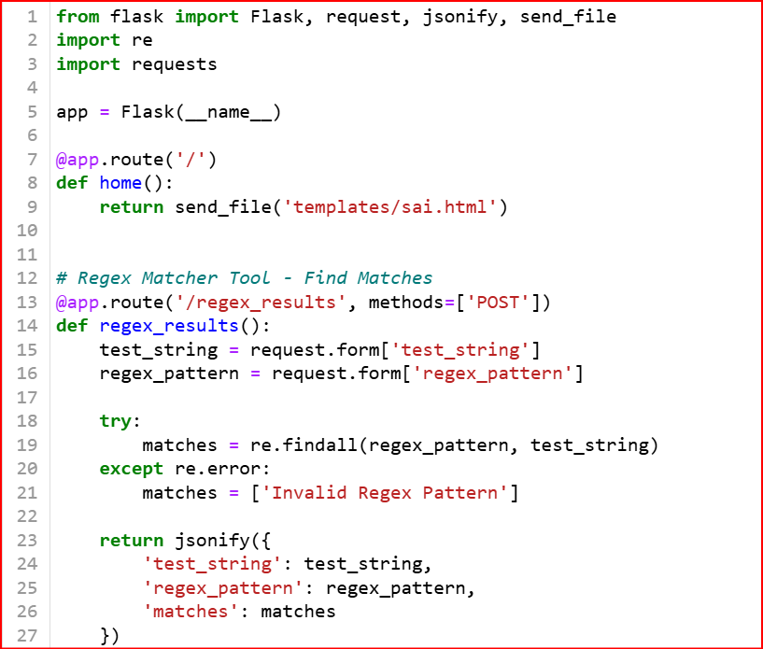
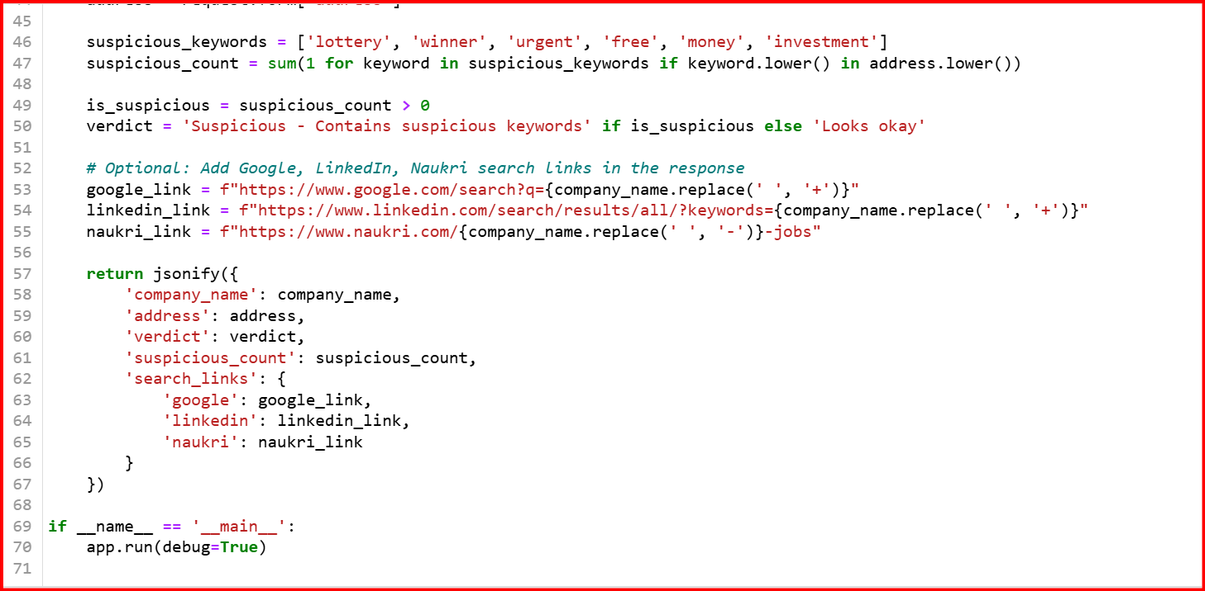
Step 1

Slide 7
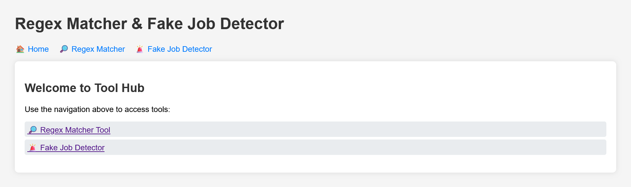
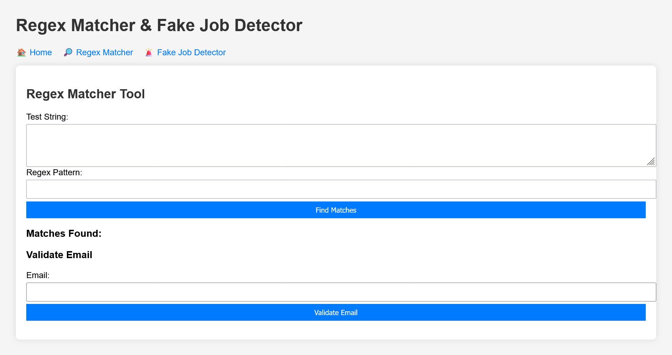
Step-2

Slide 8
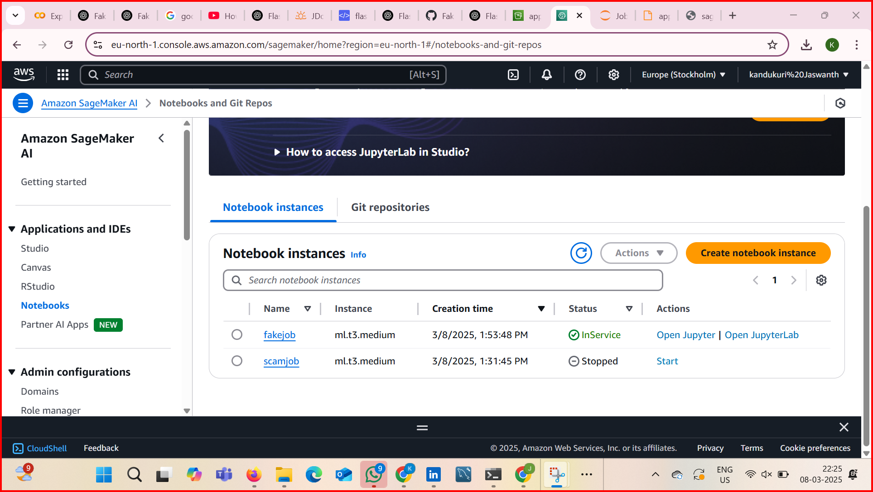
Deploying Code in AWS SageMaker
Step 1: Setting Up AWS SageMaker
Created a Jupyter Notebook instance in AWS SageMaker
Uploaded the ML model and Flask application files
Step 2: Configuring Inference Endpoint
Created a real-time endpoint for ML model predictions
Deployed the trained model to be used by Flask app

Slide 9
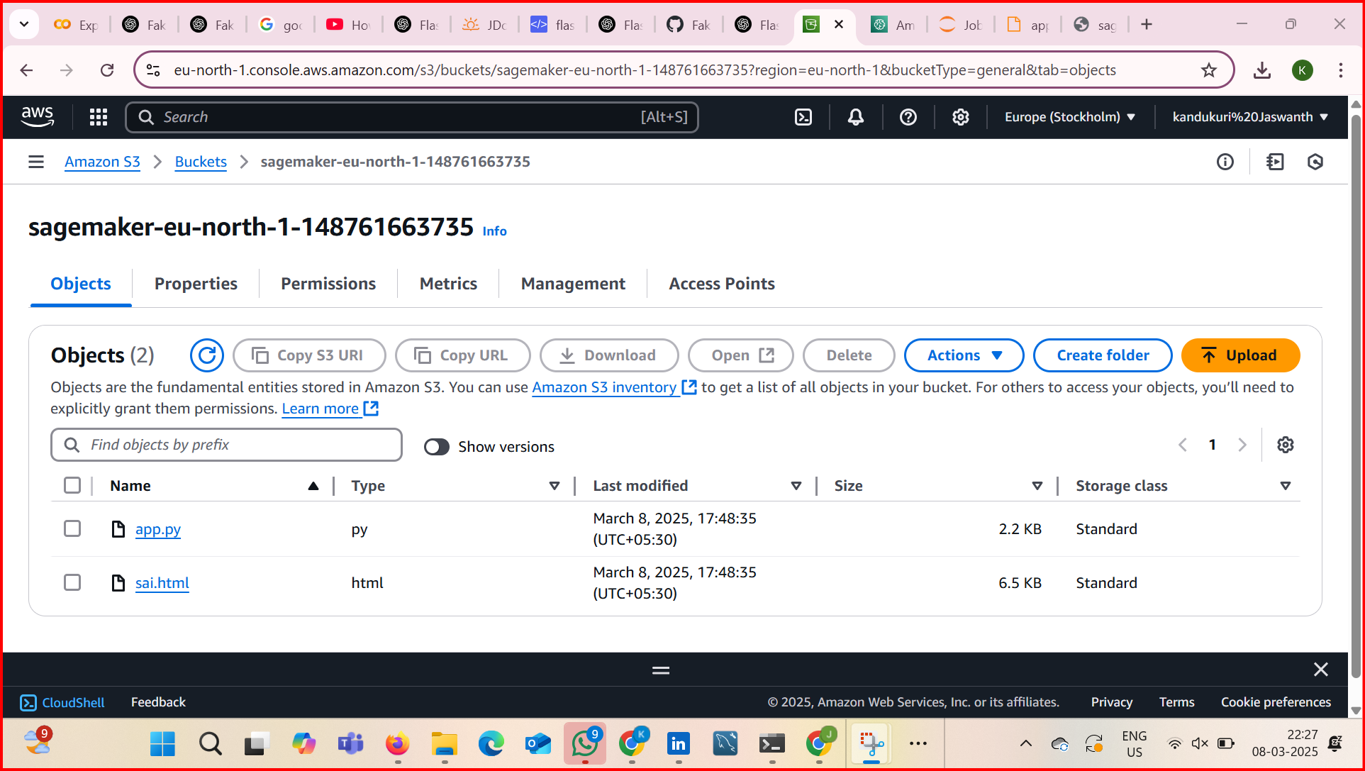
Connecting with S3 Bucket
Step 1: Creating an S3 Bucket
Opened AWS S3 → Created a new bucket
Uploaded required datasets and model files
Step 2: Allowing SageMaker Access
Configured bucket permissions
Ensured Flask app could read/write from S3

Slide 10
Setting Up IAM Role & VPC
Step 1: Creating IAM Role
Created an IAM role with necessary permissions
Assigned permissions for SageMaker, S3, and EC2
Step 2: Configuring VPC
Ensured SageMaker runs in a secure network
Allowed internet access for inference requests

Slide 11
Running the Flask App
Started the Flask app (app.py)
Sent job details from sai.html to AWS SageMaker
Received predictions and displayed results
The public URL for app.py and sai.html is:
App.py:
https://sagemaker-eu-north-1-148761663735.s3.eu-north-1.amazonaws.com/app.py.
Sai.html: https://sagemaker-eu-north-1-148761663735.s3.eu-north-1.amazonaws.com/sai.html
Github: https://github.com/KandukuriJaswanth/Job-scam-Dectector

Slide 12
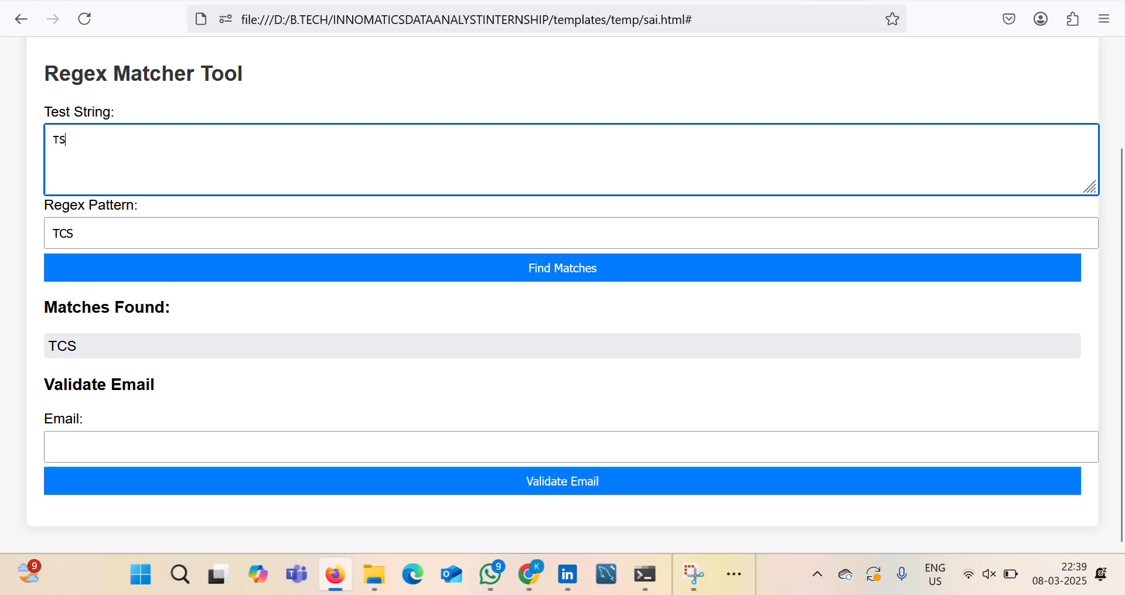
Testing & Validation
Tested with real job postings
Verified that fake job detection works accurately

Slide 13
Challenges Faced
Handling large dataset in AWS
Configuring IAM permissions correctly
Setting up SageMaker inference properly

Slide 14
Conclusion
Successfully deployed Fake Job Detection model
Integrated Flask app with AWS services
Used S3, IAM, VPC, and SageMaker for deployment
Future scope: Enhancing model accuracy & adding user authentication

